Slide 1

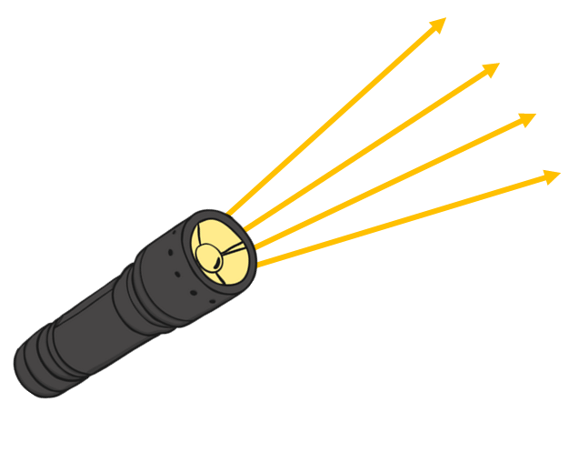
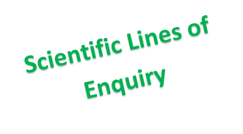

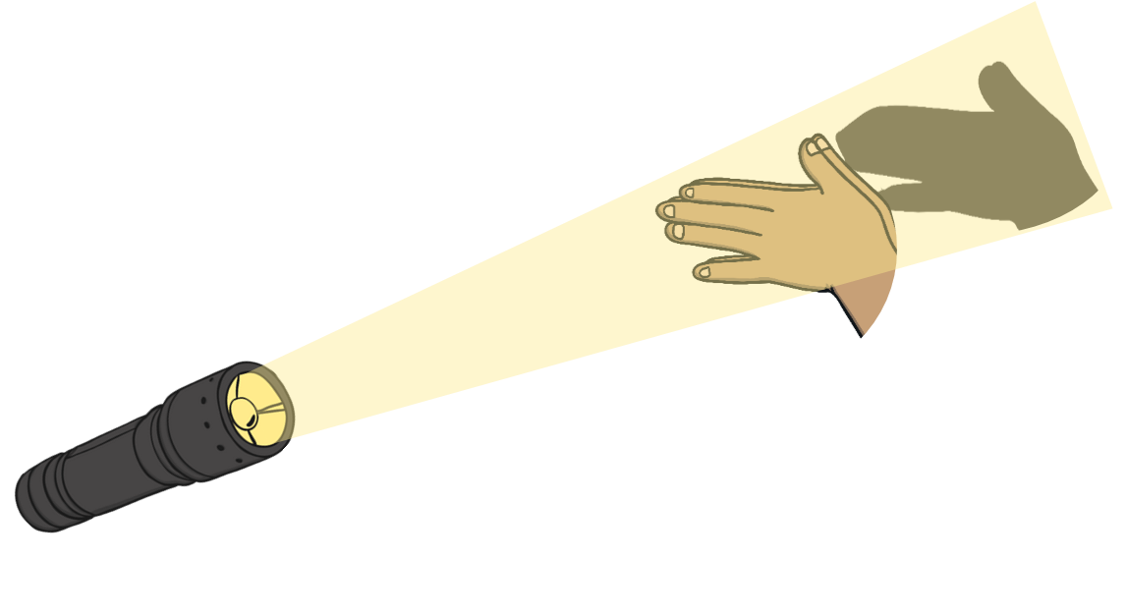
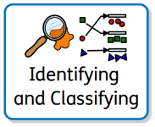
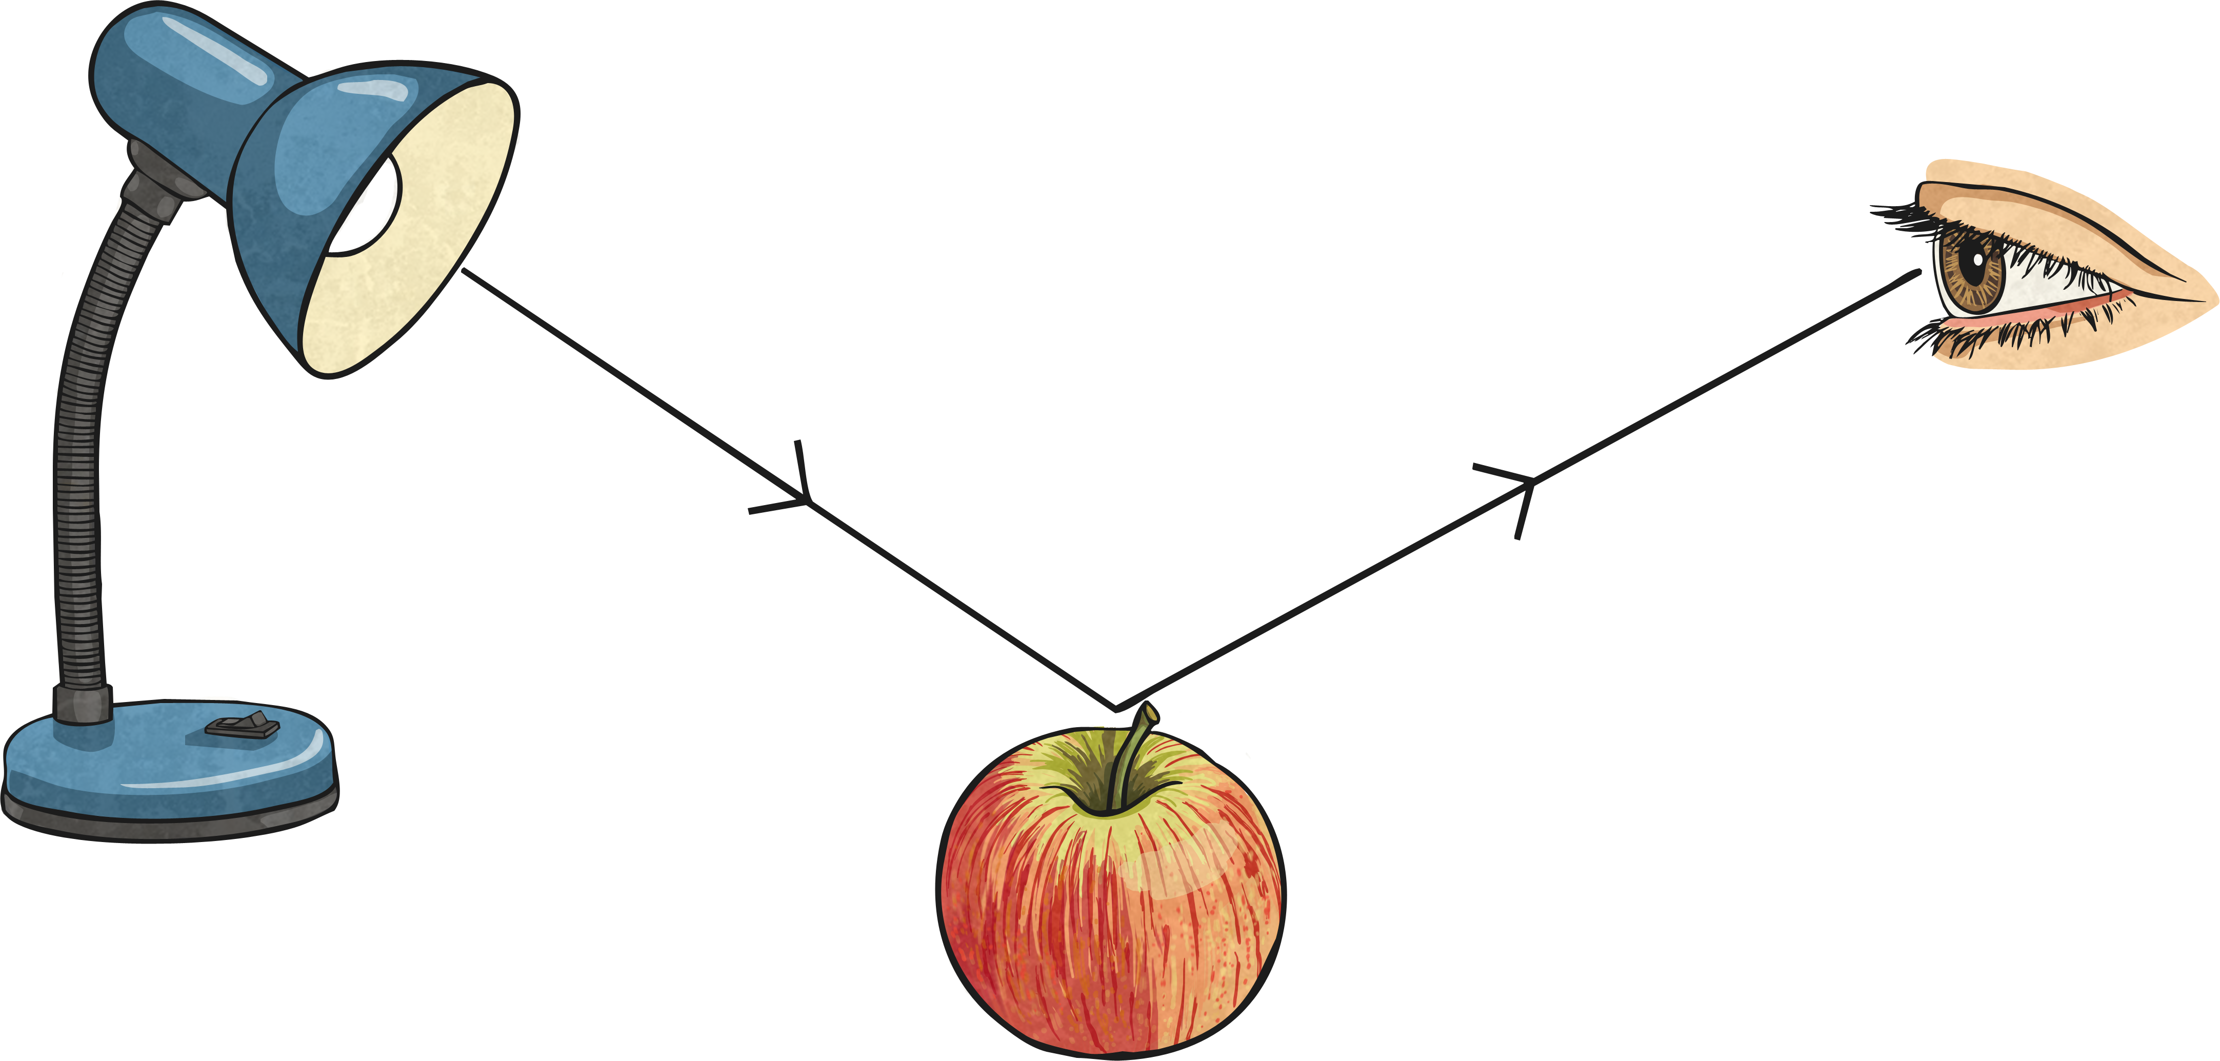
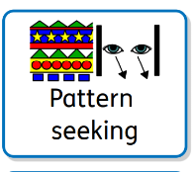

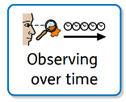
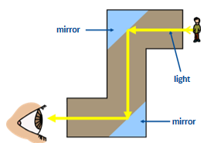
Science – Light
Shadow
Key Vocabulary
light | A form of energy. It is the brightness that allows us to see things.
optical | Term used when referring to the science of sight and the action of light.
light source | A light source is anything that makes light. Natural light sources include the Sun and stars. Artificial light sources include lamp posts and televisions.
light rays | A light ray or beam of light is a directional projection of light energy radiating from a light source.
absorb | To soak up or take in.
reflect | When light from an object is reflected by a surface, it changes direction. It bounces off the surface at the same angle as it hits it.
shadow | A dark area or shape produced by a body coming between rays of light and a surface.
Light travels in straight lines from a light source.
Shadows are the same shape as the objects that cast them because light travels in straight lines.
Reflection and How we see
We see things when light enters our eyes. Light may come directly from the source to your eyes (e.g. when
A shadow can change size depending on the distance the object is from the light source. Shadows can also be stretched out or shortened depending on the angle of the light source.
looking at a candle) or reflect off objects and into your eyes (e.g. when looking at a book).
Light reflects of some materials better than others. Smooth, shiny surfaces (e.g. mirrors and polished metals) reflect light well. Dull, dark and black objects absorb most of the light, making them harder to see.
Periscopes
Periscopes use a pair of mirrors to allow you to see round objects easily.
Notes:
Images from twinkl and CPG plus (KH subscription)

