Slide 1

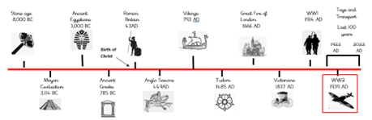
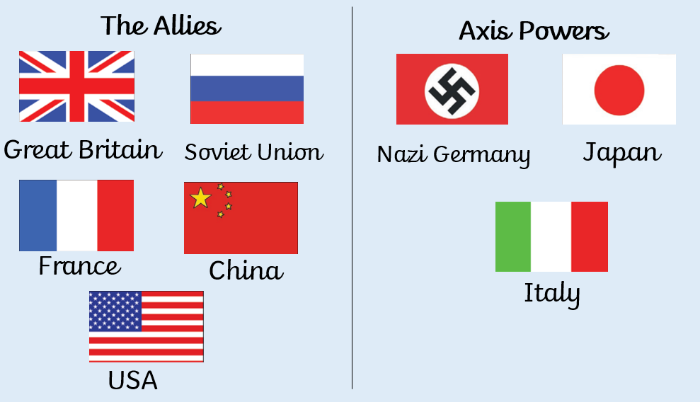
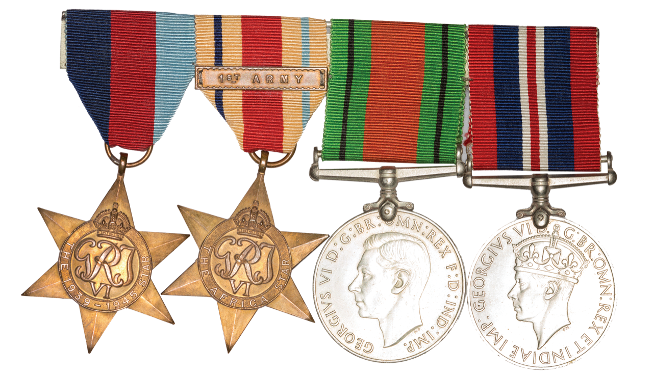
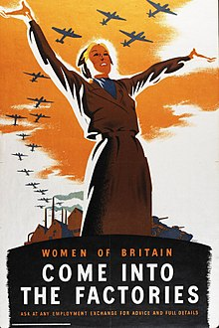
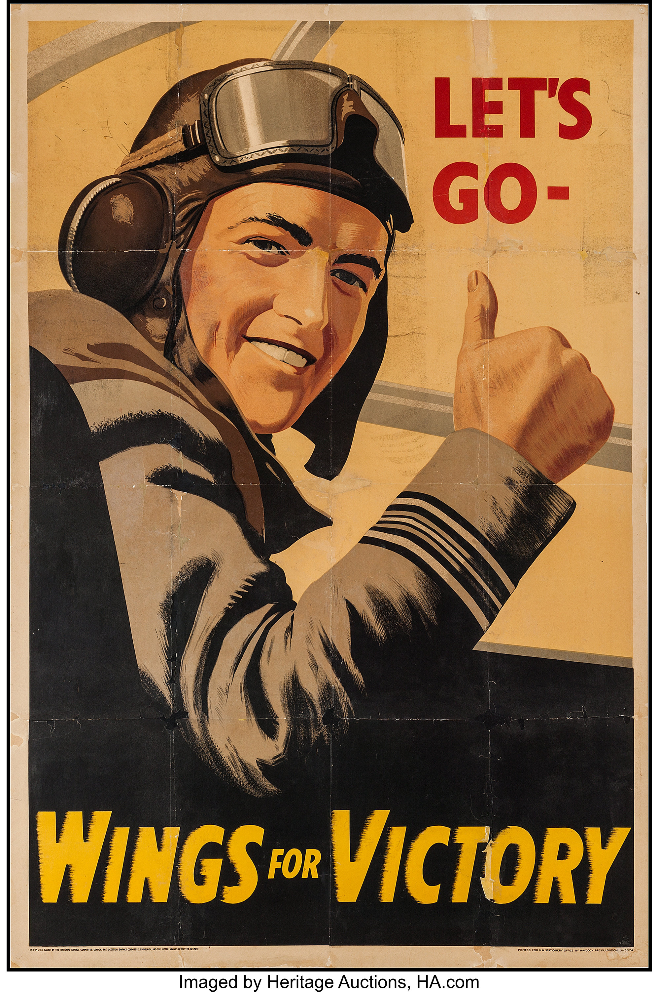
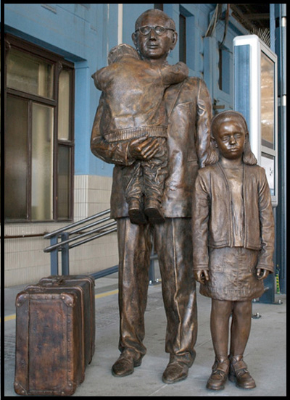
Why is it so important to remember the past?
Sticky Knowledge
On September 1st 1939, Hitler invaded Poland. 2 days later, France and Britain declared war on Germany, beginning WWII.
Evacuation was the movement of women, infants and children from cities to the countryside to keep them safe from bombing.
The Battle of Britain was a major air campaign fought between RAF (Britain) and the Luftwaffe (Germany).
The Blitz happened from September 1940 to May 1941. It was a sustained bombing campaign carried out on British cities, towns and ports to destroy factories and prevent trade leaving the UK.
Nottingham was targeted during the Blitz because of what The Lace Market Raleigh, Boots and Rolls Royce provided for the war effort.
Traditional women’s roles were revolutionised during the war as part of the ‘home front’ because they were needed to complete jobs that men would have done if it wasn’t for the war.
The Holocaust was the mass genocide of Jewish people. Nazi’s built concentration camps like a prison to prevent certain demographics from being part of the war.
Germany surrendered in May 1945.
WWII had a national impact: NHS, rationing, homelessness and poor health.
Vocabulary
Nazi | A member of the political group led by Adolf Hitler that ruled Germany from 1933 to 1945.
Allies | The group of countries fighting against Germany during WWII.
Axis | The group of countries led by Germany in WWII.
Luftwaffe | The German air force during WWII.
Genocide | Trying to murder a whole group of people.
People collect war memorabilia (including medals) because they have historical significance or sentimental value.
Contributing factors to WWII
1918 | Germany lost WWI.
1929 | The ‘Great Depression’.
1933 | Hitler became chancellor.
1939 | Hitler invaded Poland.
Propaganda
Propaganda was used by the British and German governments to influence the general public.
Sir Nicholas Winton

