Slide 1

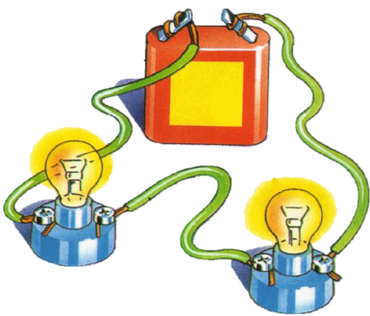
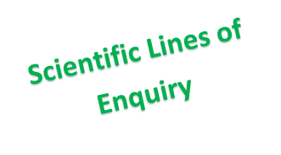
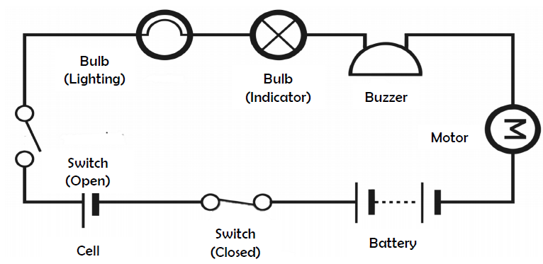

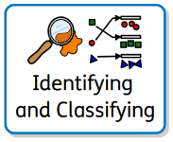
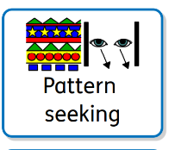
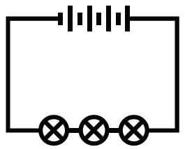

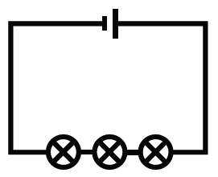
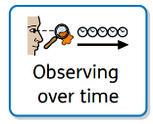
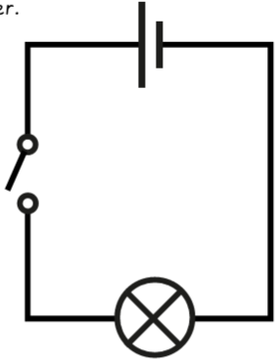
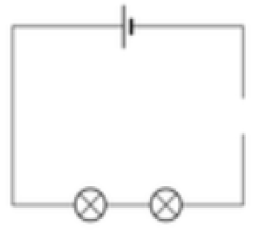
Science – Electricity
Electricity is an energy which can be used to power electrical items.
When drawing electrical circuits, you should use the standard symbols to show the different components.
Key Vocabulary
Circuit | A circuit is a closed loop that an electrical current can flow around.
Symbols | Scientific symbols can be used to represent the components in a circuit. (see diagram)
Insulator | An insulator is an object that does not allow electricity to flow through it easily. Rubber, paper and some plastics are good insulators.
Conductor | A conductor is an object that allows electricity to flow through it easily. Objects made of metal are good conductors.
Component | A part or element used in a circuit. (cell, bulb, buzzer, motor)
Cell | Supplies electrical energy. A cell is a single component.
Battery | A battery is a collection of cells.
Switch | A switch turns an electrical circuit on or off by breaking or completing the circuit
Current | A measure of how much electrical charge flows through a circuit. (amps)
Voltage | The measure of how much energy is carried by electrical charge; the ‘push’ from the power source (volts)
Electrical circuit symbols
A circuit will always have a cell or battery as well as other components connected using wires. Components such as bulbs, buzzers, switches and motors, need a battery in order to work.
Variation of components
When changes are made to circuits, components can function differently.
The brightness of a bulb or the loudness of a buzzer is affected by the number of cells in a circuit.
When more bulbs are added to a circuit, they will be dimmer than if there was one bulb. This is because the electricity is shared between the two bulbs. More voltage would be needed to make them brighter.
When switches are open or wires are removed from a circuit (so that it breaks the circuit), bulbs and buzzers will turn off.

